Slide 1
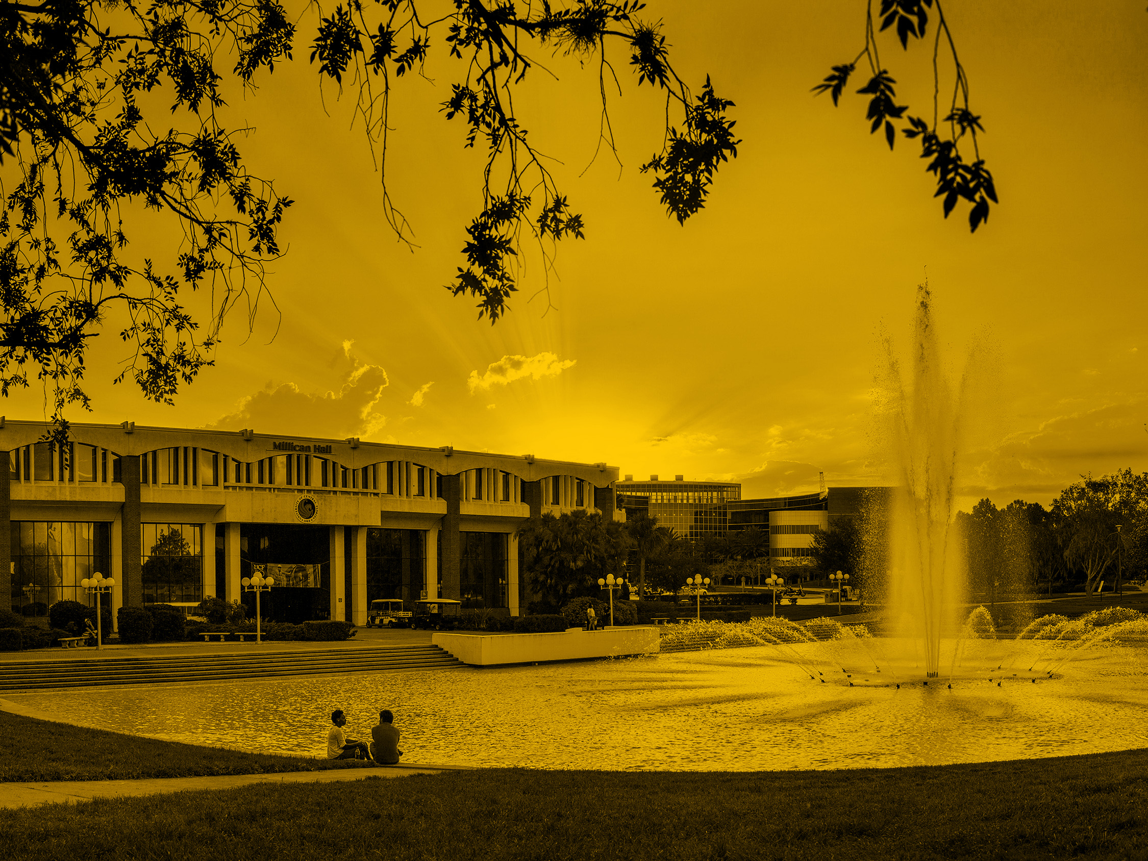

Academic Disciplinary Actions –
Erosion of Tenure
Chuck Reilly, UCF, Assistant Vice Provost and Professor

Slide 2
Conjecture:
An academic disciplinary action is a very inefficient way to bring about the erosion of tenure.

Slide 3
UCF has one union for FT faculty who have no management duties and for some professional employees, such as librarians, instructional designers, and counselors.
Our CBA calls for progressive discipline (from reprimand through termination). Letters of instruction are not considered discipline.
Many disciplinary actions are grieved, as were two LOIs.
Arbitrations seem to be becoming more common.

Slide 4
Interesting dilemma for our union:
Members concerned about the time for OIE to complete, say, a Title IX investigation; they want quick, decisive action.
2016: RHW recommended for discipline by OIE for questionable conduct but not for sexual harassment and discrimination.
Union supported RHW’s grievance of LOR all the way through arbitration.

Slide 5
Ex: recent actions at UCF
Initials | When | Why | What happened
LC (T) | 2013 | COI; personal side business profited from funded projects | Resigned before termination
JJL (T) | 2017 | COI; repeated denial of affiliation with denied entity in China | Resigned before termination
RHW (T) | - 2018 | “Frequent flyer”; insubordination | Arbitration (2x); retired
HEF | 2018 | Sexual harassment, misconduct | Resigned before termination
RS (T) | 2020 | COI; failure to control unit | Retired before termination
LRJ | 2020 | COI; orchestrated plagiarized PhD | Term’d, but grieving
GT | 2020 | Collaborated plagiarized PhD | Term’d; grievance timed out
LM (T) | 2020 | Occasional flyer; failure to report arrest for sexual msg to minor; computer files | Term’d; grievance on hold till after criminal trial
ESL | 2020 | Union leader; had past issues; unauthorized use of university resources | Grieving SWOP; too late to grieve NRA

Slide 6
Time-consuming investigations and disciplinary process are not unique to UCF:
U Washington – termination took 1-2 years for faculty member who had inappropriate sexual contact with a minor in a young scholars program (Seattle Times, 12/4).
U Houston – termination took nearly a full year for faculty member who refused to teach assigned classes (The Daily Cougar, 12/5).

Slide 7

Moving on to tenure…

Slide 8
What is tenure?
AAUP, university administrations: protects teaching and creative inquiry from political and economic pressures.
Faculty: absolute job security (and real academic freedom).

Slide 9
How has tenure changed over the last 50 years?
WSJ (12/6):
More than 70% of faculty in the U.S. were tenured or on the tenure track.
About 30% are tenured or on the tenure track today.

Slide 10
“Assaults” on tenure:
- Incentives to retire.
- NTE, adjunct replacements (e.g., UCO-Boulder, IHE, 12/4).
- Post-tenure review.
- Multi-year agreements instead of tenure.
- Program closures/layoffs (Centenary U, CHE, 2/16; U Vermont, IHE, 12/7).
- Rescission of tenure (Medaille College, WSJ, 12/6).

Slide 11
First Question:
Are closures of programs and rescissions of tenure efficient, but indirect, ways to address academic disciplinary matters?

Slide 12
Real Questions:
What are the challenges you and your institution are facing with academic disciplinary actions?
How is tenure being eroded or strengthened at your institution? Willfully? Or because of other actions?
What has been the impact of COVID-19 on academic disciplinary actions and/or the future of tenure at your institution?
How are all these things affecting bargaining at your institution?

Slide 13
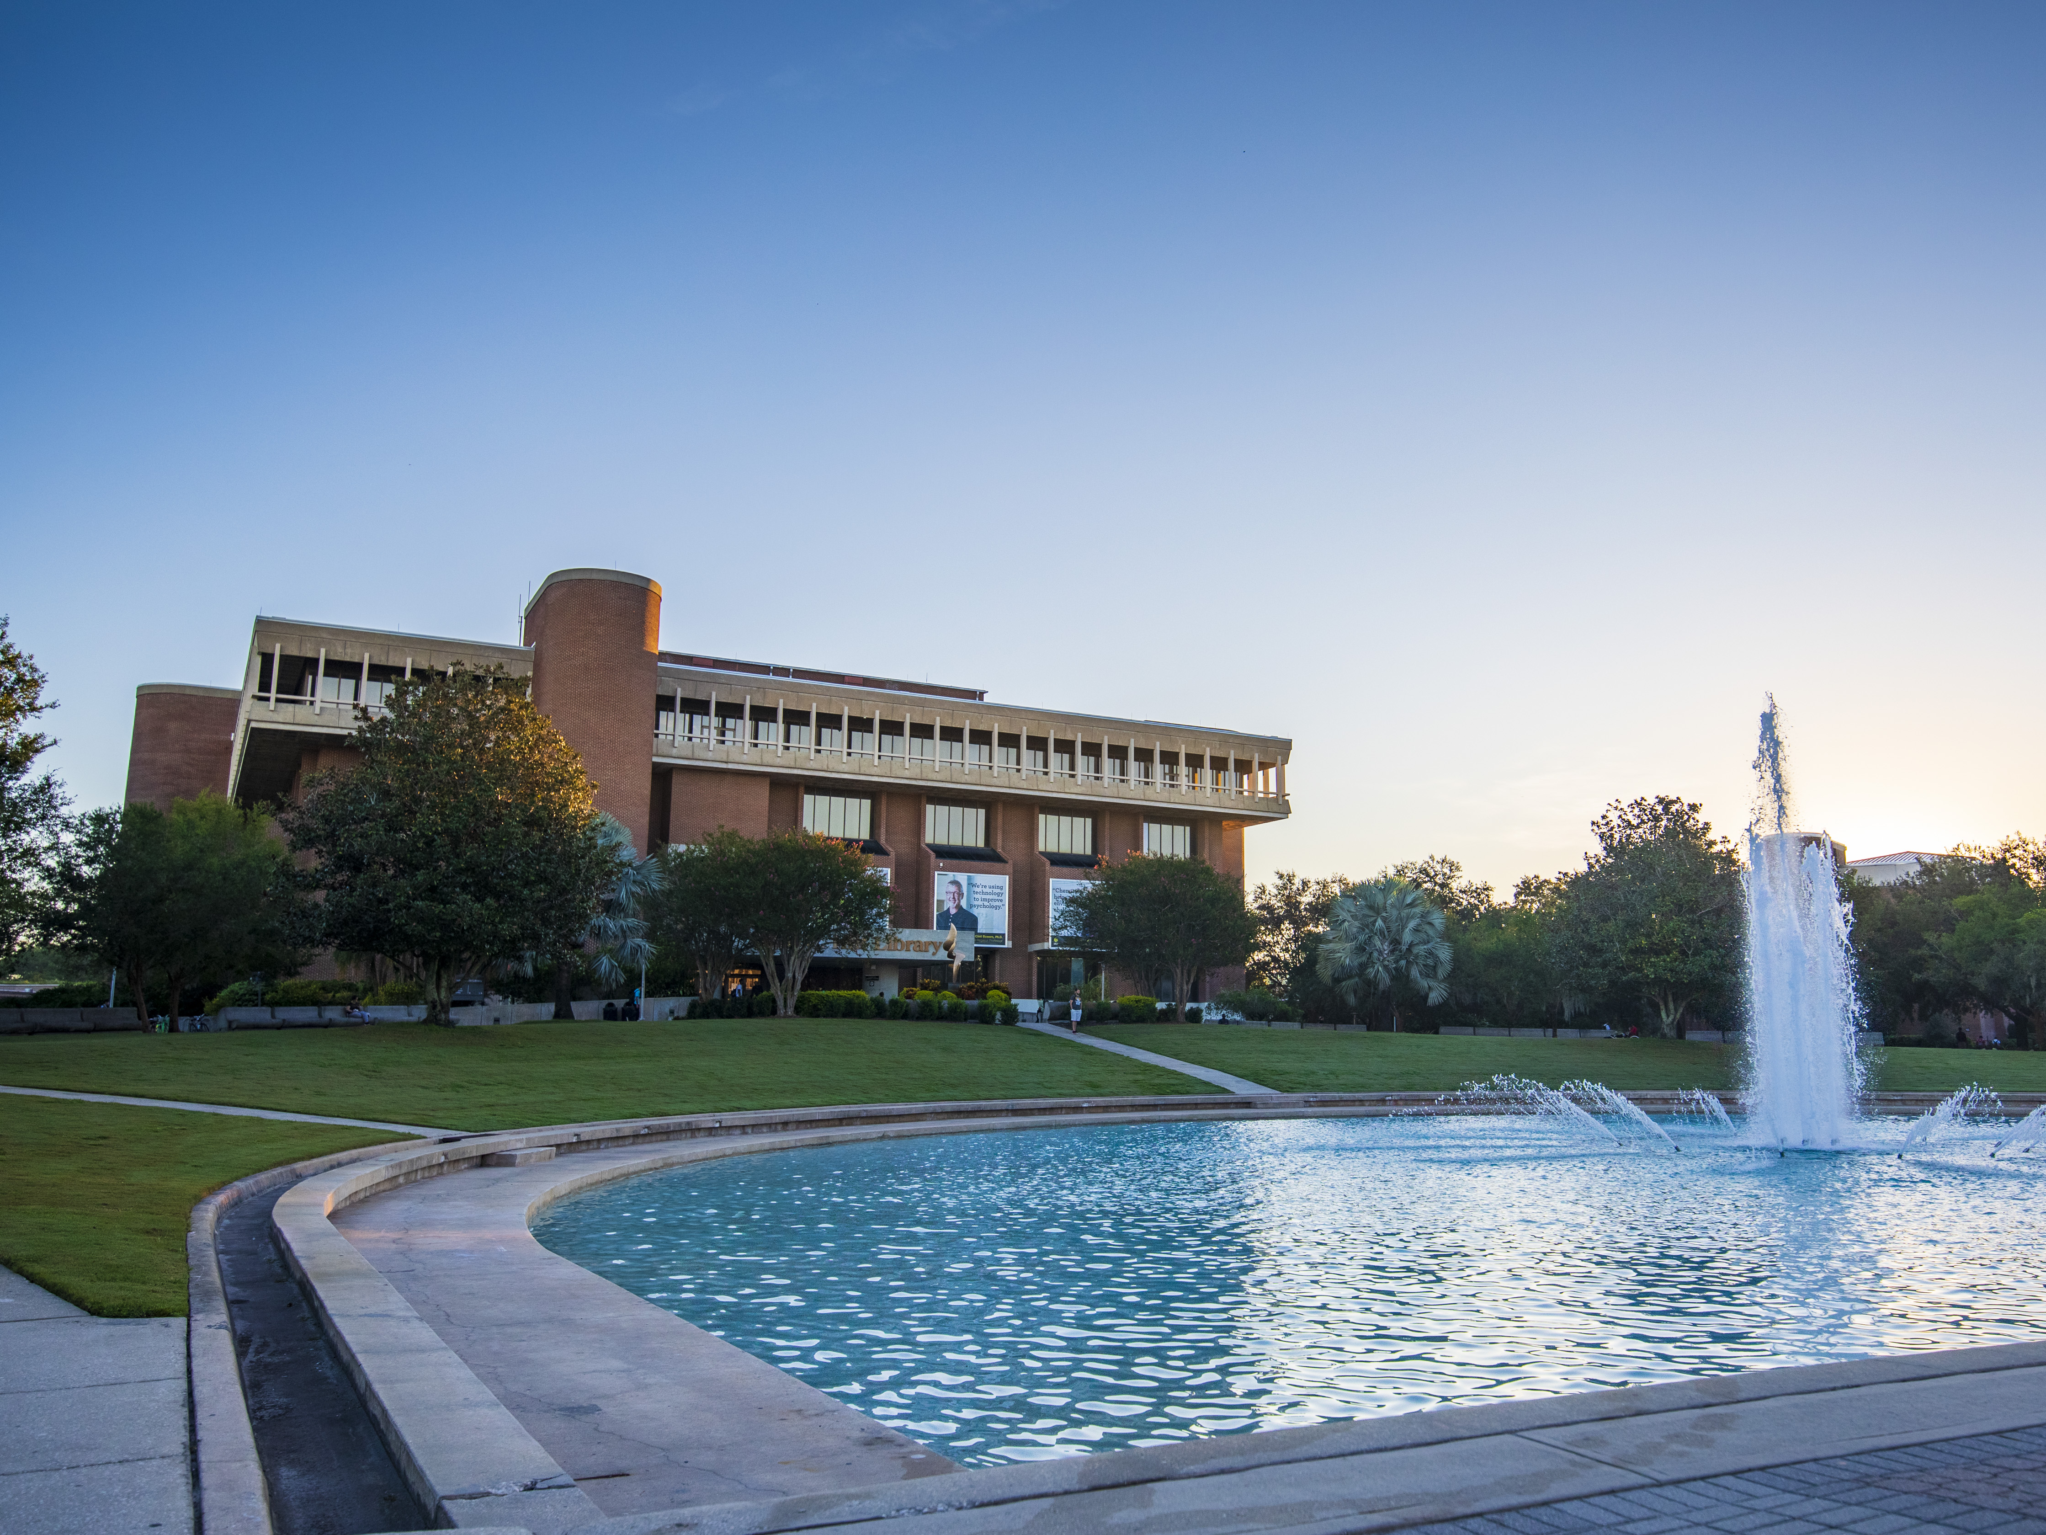
Thank you!

