Slide 1
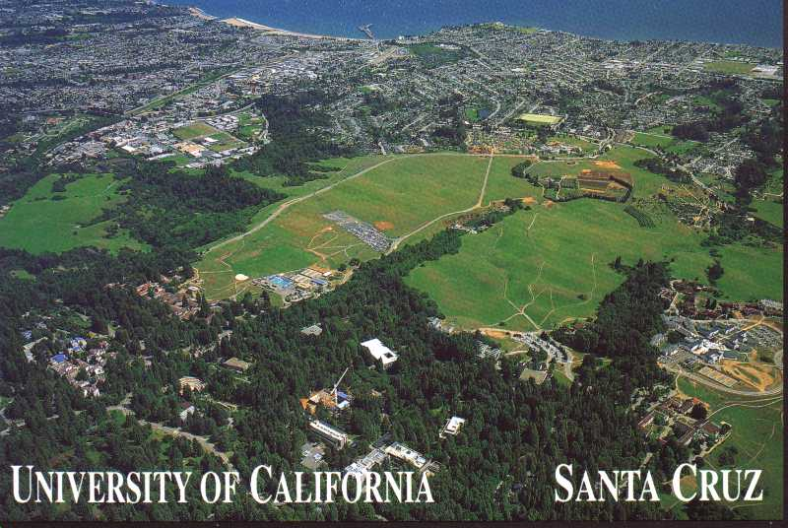
Anatomy of a wildcat strike
Nadine Fishel
University of California
AAPA Annual conference – December 11, 2020

Slide 2
Overview of bargaining unit
Academic student employees: teaching assistants, readers and tutors
10 campus locations
  Berkeley
  Davis
  Irvine
  Los angeles
  Merced
  riverside
  San Diego
  San Francisco
  Santa Barbara
  Santa cruz
13,000 – 15,000 unit members in any given academic year

Slide 3
Understanding the agreement
The uaw 2865 and the university of California had a 4 year deal locked up from august 2018 – june 2022
Compensation – 3% increases each year on October 1st
Remissions – tuition, fee and health care remissions included – 1% additional remission added in agreement
Housing – union raised and university rejected on the basis that housing is paid for out of compensation
No strikes article in place
Waiver article in place

Slide 4
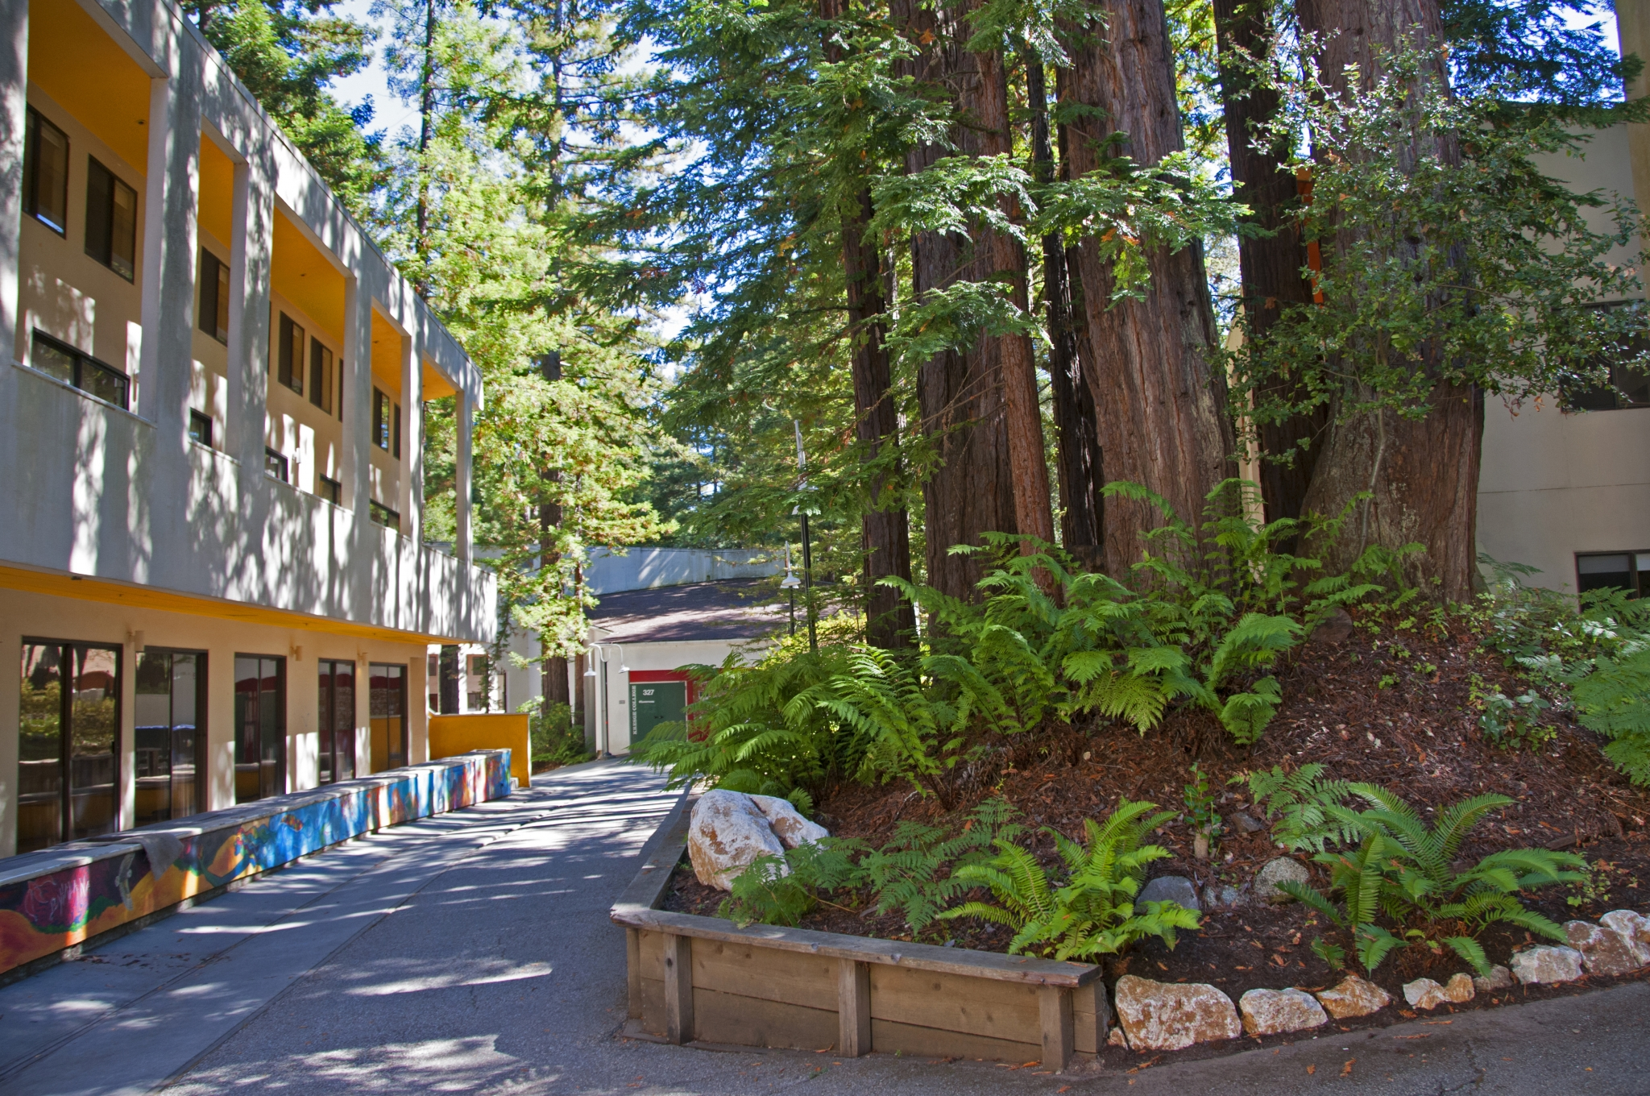
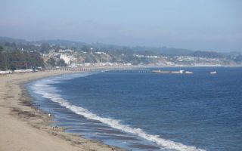
the perfect storm

Slide 5

Rise of unrest fall 2019
Housing costs spin out of control
  Not enough on campus housing
  Silicon valley drove up market prices
Union leaders meet with administration
  Union wants to reopen agreement to increase compensation – provide a cola
  University asserts the zipper clause
Union leaders take to the base of campus
  Wildcat strike – cost of living adjustment
  Withhold grades – fall quarter 2019

Slide 6
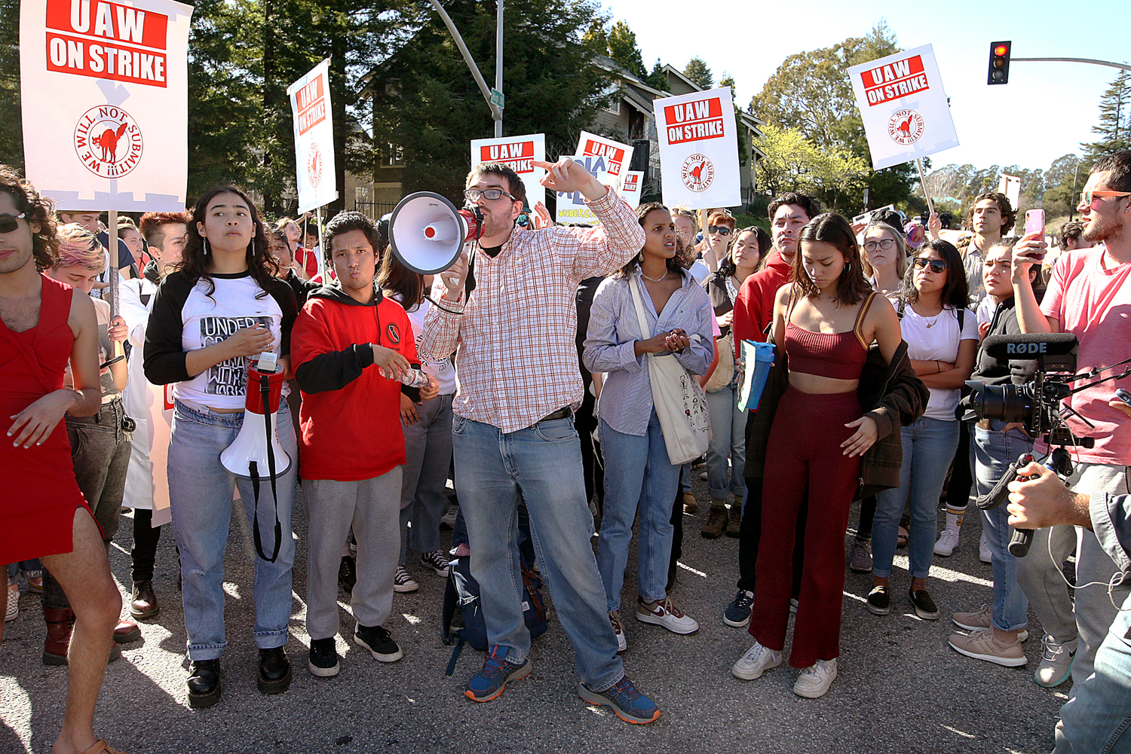
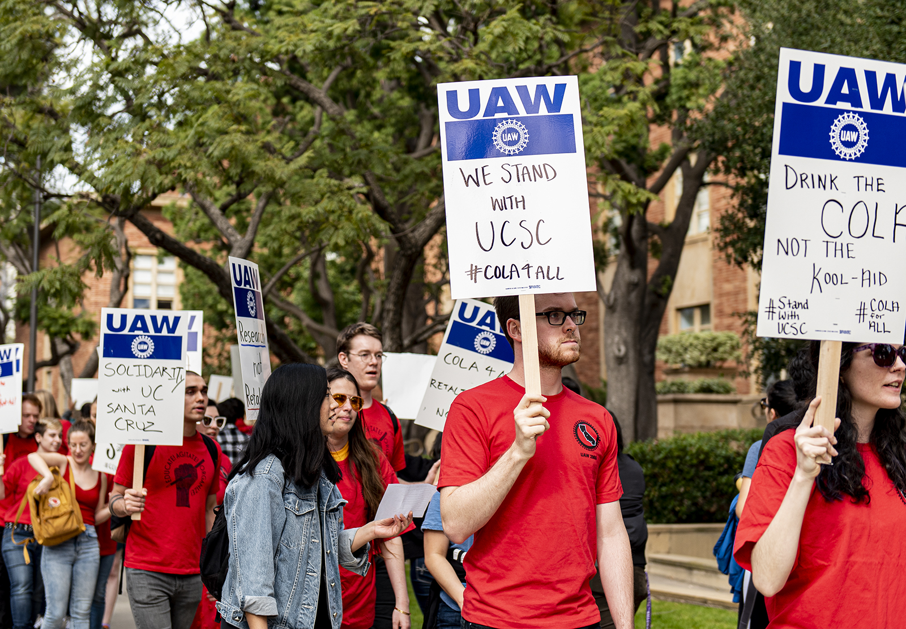
COLA 4 ALL
UC SANTA CRUZ RALLY
UCLA RALLY

Slide 7
JOINT LABOR MANAGEMENT COMMITTEE
WINTER 2020
All campuses
Different issues at each
  Cost of housing
  Availability of housing
Union wanted 30% of gross income spent on housing
Pay stipend

Slide 8
Santa cruz campus response
WINTER 2020
Wildcat strike is Out of control
  faculty participation in sympathy
  Other campuses demonstrating
Trying to identify who is withholding grades proved difficult
  Deadline to submit – threat of discipline
  Deadlines extended multiple times – watered down threat
Teaching assistants out on strike
  Faculty take over duties (file grievances on workload)
  Grades withheld and deleted
  Liberating dining halls
Campus leadership meets with graduate student association
  Provides $2500 per student fellowship funding

Slide 9
Unfair practice charges
WINTER 2020
University strikes first
  Union failed to discharge duties under no strikes article
  Union disavows wildcat, but signs, t-shirts and social media say otherwise
Union files 2 charges
  University “negotiated” with the graduate student association
  University disciplined “disparately” – 41 Teaching assistants were terminated

Slide 10
Pandemic effects spring 2020
Campus retreats into remote learning
41 terminations
  Appointments for spring withdrawn for cause
  Protests over unfair treatment on social media
Hush falls over the campus
Focus on covid-19

Slide 11
Settlement of discipline summer 2020
Hired a mediator and spent 2 days working through issues
Disparate facts – 41terminated; more participated in grade withholding, but turned in earlier and weren’t terminated
All grades were eventually turned in
Agreement
  Sealed files of 41- 2 years if no further engagement or unseal files
  Allow to teach fall term

Slide 12
Unfair hearing and settlement discussions fall 2020
Perb appoints alj to mediate dispute
Parties have met over dozen times to attempt settlement
  Union wants cold, hard cash
  University wants process like joint labor management meetings
Hearing
  Began December 1
  Continues January 4-8
Settlement impediments
  Both sides need face savers
  Both sides grounded in positions

Slide 13
Potential aftermath
Settlement is still possible now and in the future
Hearing results - spring 2021
  University loss – order to return to the bargaining table
  Union loss – get control over situation – wait to bargain – 2022
  Appeals – prolong
Agreement expires June 30, 2022

