Slide 1
Paid Family Leave Policy Trends
AAPA Conference 2020
Bill Connellan, Assistant Provost and Chief Bargainer
Shannon Edwards, Director, University Benefits
University of Florida
December 11, 2020

Slide 2
BACKGROUND
Bargaining new 3-year contract
18 months to bargain
Complicated issues
Union team of 10 had never been at table
University team had 2 new members

Slide 3
SIGNATURE PROVISION
We believe it is a national model
Designed by Shannon Edwards and her HR team
Could expand in future years
We are happy to talk with any who might be interested in pursuing

Slide 4




Slide 5
ARTICLE 21
Other Leaves

Slide 6
PAID PARENTAL AND MEDICAL LEAVE

Slide 7
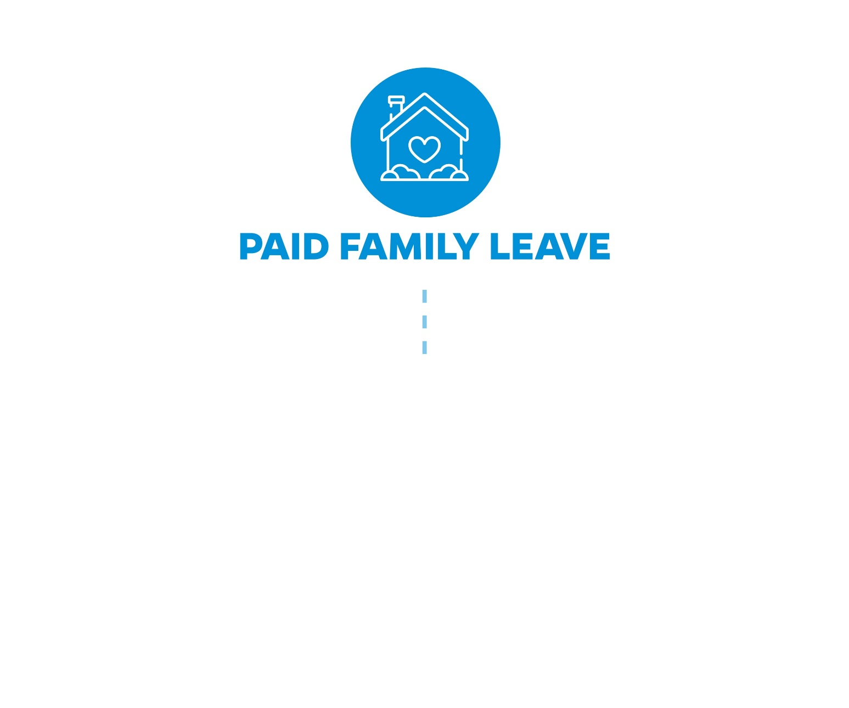
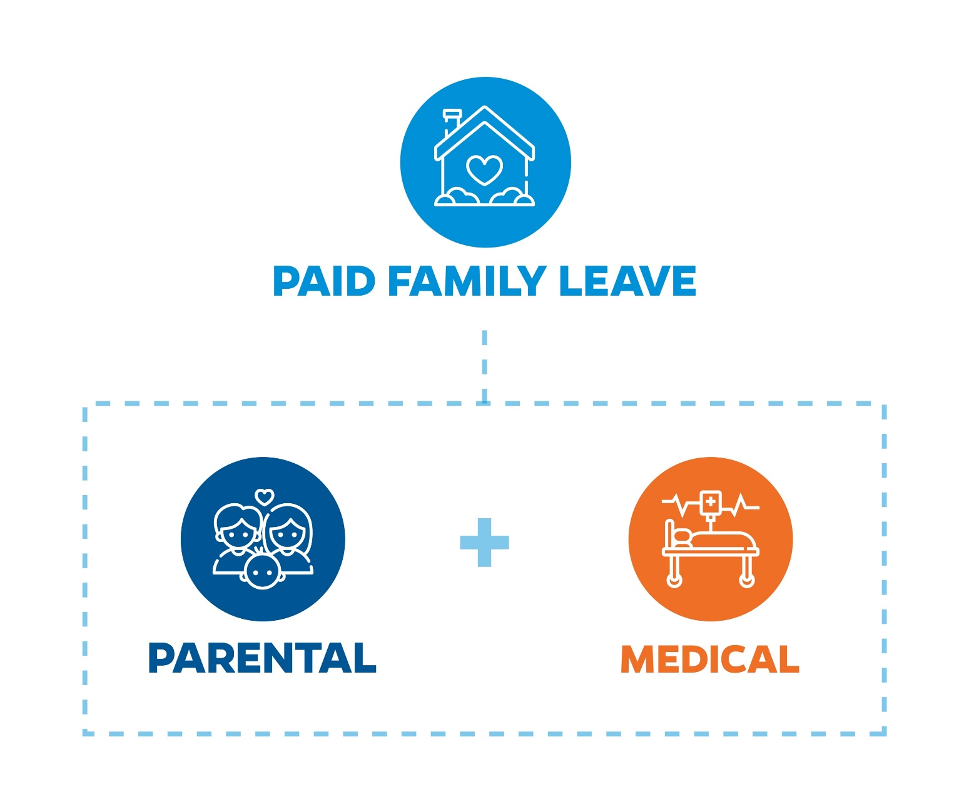
NEW! PAID PARENTAL AND MEDICAL LEAVE
Provides up to 8 weeks of paid family leave in a rolling 24-month period for full-time faculty and staff to support improved work-life balance and to protect against income loss during major life events.
These 8 weeks count toward FMLA entitlement. Employees can use this time in one of two ways:
  Parental: to cover absences related to parental leave (birth, adoption, fostering)
  Medical: a personal illness/injury, or an immediate family member’s serious illness/injury
Employees are not required to exhaust their accrued leave in order to use this benefit.
Paid Family Leave is available beginning Jan. 1, 2021

Slide 8

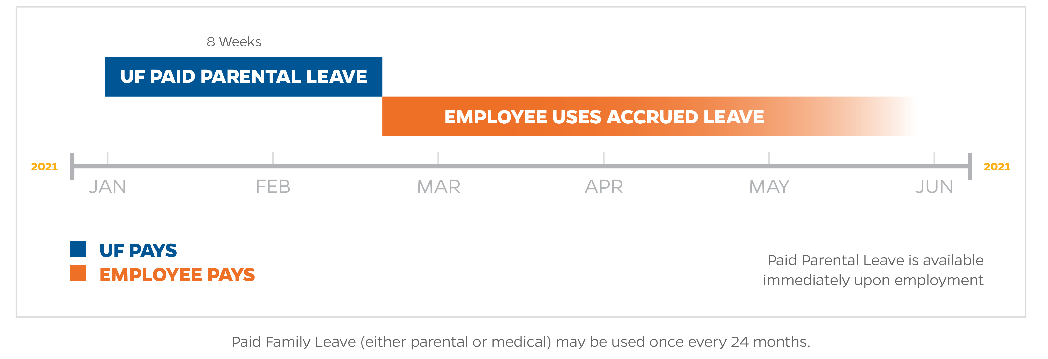
PAID PARENTAL LEAVE
Parental:
Parental Leave is available to all faculty and staff upon beginning work with the University of Florida. A maximum of eight (8) weeks of parental leave is available to both parents or legal guardians in cases of birth, adoption, or placement for fostering. This leave must be taken within twelve (12) months of the birth or placement of a child and may be used intermittently.
Current leave balances owed for those that participated in the parental pay back program will be forgiven 1/1/21
Paid Family Leave is available beginning Jan. 1, 2021

Slide 9
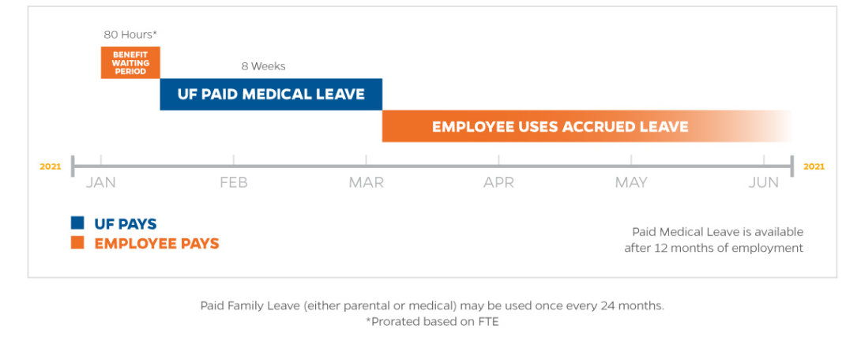
PAID MEDICAL LEAVE
Medical:
Medical Leave is available to all faculty and TEAMS after twelve (12) months of continuous service as faculty or TEAMS with the University of Florida. In order to qualify for medical leave, an employee must provide certification from a medical provider for an FMLA qualifying event. Prior to accessing medical leave, employees must first use 10 days (80 hours) of accrued leave (after 7/1 - PTO or hours accrued in their Sick Leave Savings Account). Once those eighty (80) hours have been used, a maximum of eight (8) weeks of paid medical leave will become available to the employee, to be used in one-week increments.
Why 10 Days?
• In-line with short-term disability plans
Paid Family Leave is available beginning Jan. 1, 2021

Slide 10
A PROGRESSIVE APPROACH TO PAID TIME OFF

Slide 11
LEAVE BENEFITS ATTUNED TO OUR FACULTY AND STAFF’S NEEDS
Add Paid Family Leave
Parental and Medical
Continue:
  No change to cash-outs upon termination
  10 Paid Holidays
  Administrative Leave (Defined by CBA)
  December Personal Leave (Eligible Faculty & TEAMS)
  Sick Leave Pool
Convert to Paid Time Off
TEAMS & 10/12-Month Faculty: Accrue 10 hours bi-weekly(pro-rated based on FTE)
9-Month: Accrue 4 hours bi-weekly
The loss of 2 days of vacation accrual annually enables us to provide an 8-week benefit to all Faculty and TEAMS employees every 24 months in the event they need it.
Create a Sick Leave Savings Account for each employee

Slide 12


WHAT IS PAID TIME OFF
Combining vacation, sick days into one bank and one accrual
Slight adjustment to hours accrued bi-weekly
Enables us to provide a paid leave benefit available at all stages in life
TEAMS & 10/12-Month Faculty: Accrue10 hours bi-weekly(pro-rated based on FTE)
9-Month: Accrue 4 hours bi-weekly
All cash-outs upon termination stay the same
Why bother?
More flexibility
Designed to promote planned time off and reduce unplanned time off
Also, for 9-month faculty, a clear distinction when engaging in approved outside activities

Slide 13

Questions

